Slide 1
BUS 203
Business Statistics
Instructor: Dr. Hakan Gürsoy
Course Hours:
Section 2 : Tuesday 09.00 – 11.00
Section 1 : Wednesday 09.00 – 11.00
You may attend both sections

Slide 2
Resume
Dr. Hakan Gürsoy hakan.gursoy@ostimteknik.edu.tr
Bogazici University Management ‘03
KTO Karatay University Law 19’
ODTU/METU Computer Engineering ‘24
Columbia University Master of Public Economics ‘14
Hacettepe University PhD in Managerial Science ’23
Taxation, Accounting, Finance and Auditing Professional since ‘04
Sworn-in Financial Advisor (Yeminli Mali Müşavir)
Computer Engineer
Attorney at Law
Finance Courses in Hacettepe University and Atılım University
Data Science Courses in Atılım University

Slide 3
1. Introduction
Data - Information collected to gain knowledge about a field or to answer a question of interest.
Data Sources include:
  Surveys (Mail, Telephone, Internet)
  Experiments
  (These days, huge data sets routinely generated in other ways in business, government, at Internet sites)
Statistics- Set of methods for collecting/analyzing data (the art and science of learning from data)

Slide 4
Statistics provides methods for:
Design - Planning/Implementing a study
  Sample survey or experiment?
  How to choose people (subjects) for the study, and how many? (Most important part I believe)
Description – Graphical and numerical methods for summarizing the data
Inference – Methods for making predictions about a population (total set of subjects of interest), based on a sample (subset of the sample on which study collects data)

Slide 5
Examples
How can we study whether a new therapy is better than a standard therapy for treating depression?
How (if at all) is happiness associated with income, job satisfaction, family situation, social life, religious beliefs, political ideology?
Can we predict college GPA using IQ, average time studying per week, high school GPA, SAT scores, number of hours spent on social activities, … ?

Slide 6
Parameter – Numerical summary of the population
  Population mean (or median or some other measure)
  Population proportion (or percentage)
Statistic – Numerical summary of the sample
We’ll learn how to use sample statistics to make inferences about population parameters.

Slide 7
Examples: parameters / statistics
Parameter
% of all adult Americans who approve of Barack Obama’s performance as President
Mean reaction time to red light in experiment when using (not using) cell phone while driving
(conceptual population)
Statistic
% of 1000 adult Americans in a poll who approve of Obama’s performance as President
Mean reaction time to red light for 100 students in experiment when using (not using) cell phone while driving

Slide 8
Note:
Populations can be actual sets of people or conceptual (hypothetical)
For good inferences, need sample to be representative of population (Very important)
Statistical software (such as SPSS, Stata, SAS, R, Minitab) is used to analyze data. As a general programming language, Python, is frequently used for statistical purposes.

Slide 9
Software applies to data files
Any one row contains observations for particular subject (person) in sample
Any one column contains observations for a particular characteristic (“variable”) measured. The names of the characteristics are at top of file, in first row.

Slide 10
Examples: Go to www.stat.ufl.edu/~aa/social/data.html
The first data file, from a survey of 60 social science graduate students at Univ. of Florida, looks like:
subject gen age high coll tv veg party ideology abor
1 m 32 2.2 3.5 3 n r 6 n
2 f 23 2.1 3.5 15 y d 2 y
3 f 27 3.3 3.0 0 y d 2 y
4 f 35 3.5 3.2 5 n i 4 y
5 M 23 3.1 3.5 6 n i 1 y

Slide 11
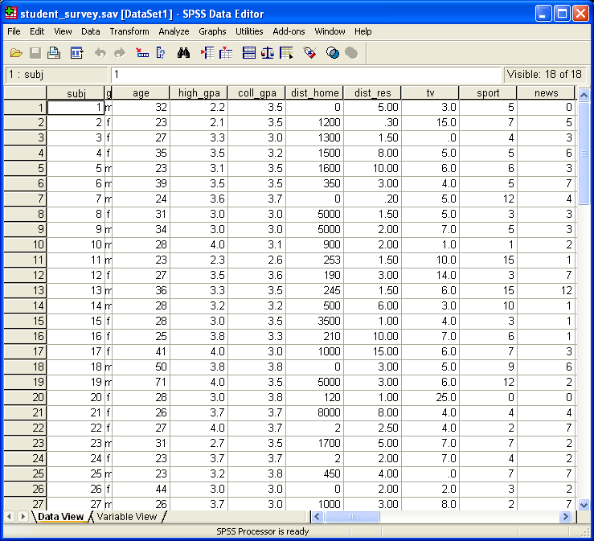
When loaded by SPSS, looks like:

Slide 12
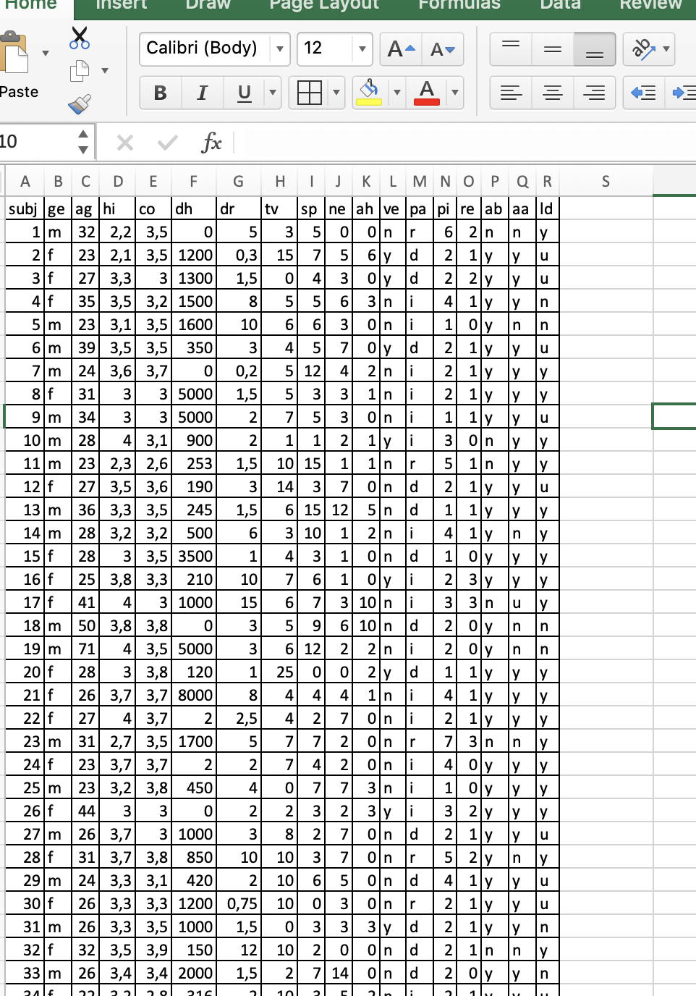
Same data on Excel

Slide 13
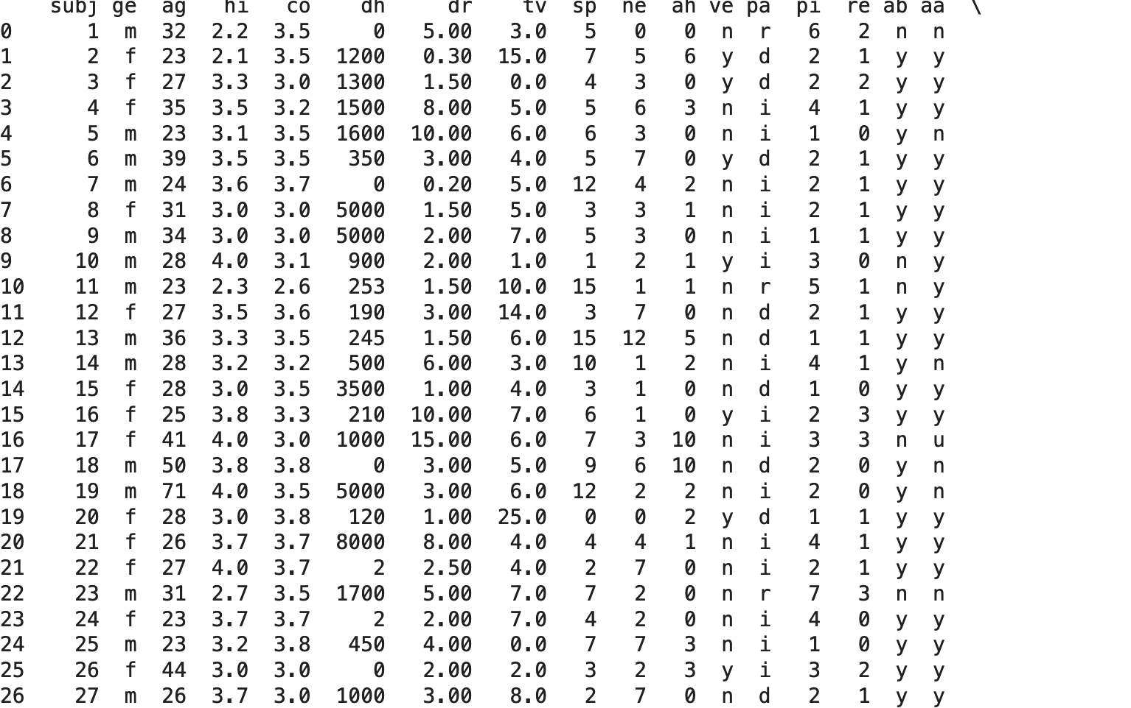
Same data on google colab notebook

Slide 14
Why study Statistics?
One answer: You need it to understand research findings in psychology, medicine, business, …..
Another answer: In a competitive job market, understanding how to deal with quantitative information provides an important advantage.
(“The sexy job of the next 10 years will be statistician” – Hal Varian, chief economist at Google, said in 2009 and it is true now)
Broader answer: In your everyday life, it will help you make sense of what to heed and what to ignore in statistical information provided in news reports, medical research, surveys, political campaigns, advertisements, …

Slide 15
Why do we need to study statistics?
https://www.youtube.com/watch?v=wV0Ks7aS7YI
This is a good video for the aim of statistics education

